Slide 1
Power Conversion
EE 542 Fall 2014
Hoang Pham, Peter Odell

Slide 2
Concept of PWM (in digital audio, quad copter) after digital PWM slide
What’s power conversion -> what it takes to control it -> what’s in digital control -> what’s in analog and why it sucks -> why digital is awesome -> advanced digital ->

Slide 3
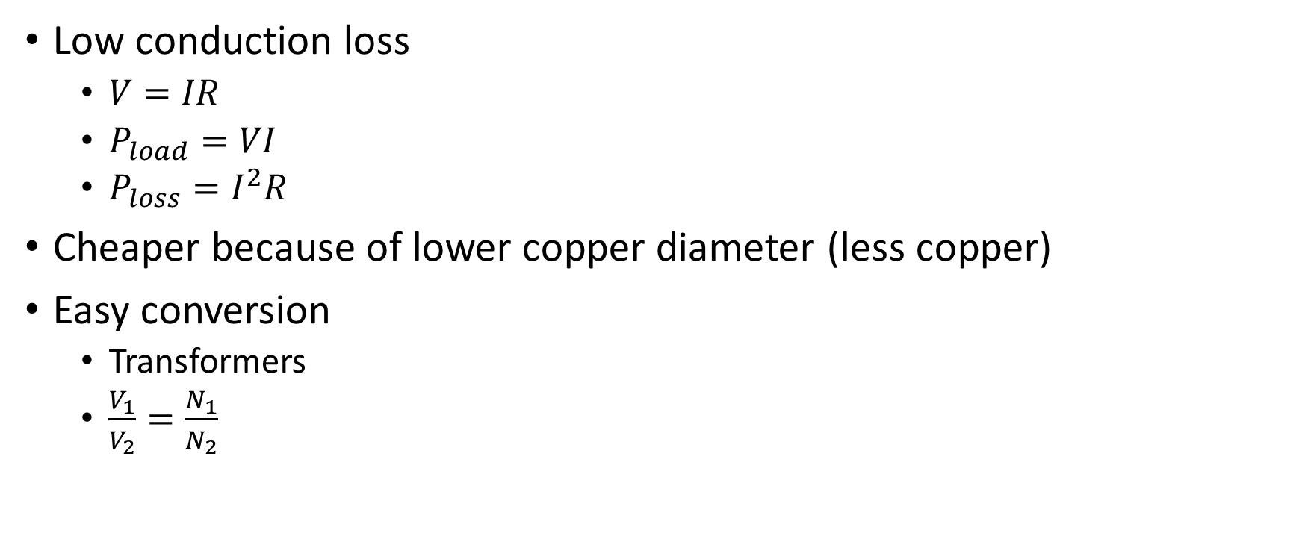
Power transmission likes AC high voltage
Low conduction loss
$V=IR$
$P_{load}=VI$
$P_{loss}=I^{2}R$
Cheaper because of lower copper diameter (less copper)
Easy conversion
Transformers
$\frac{V_{1}}{V_{2}}=\frac{N_{1}}{N_{2}}$

Slide 4
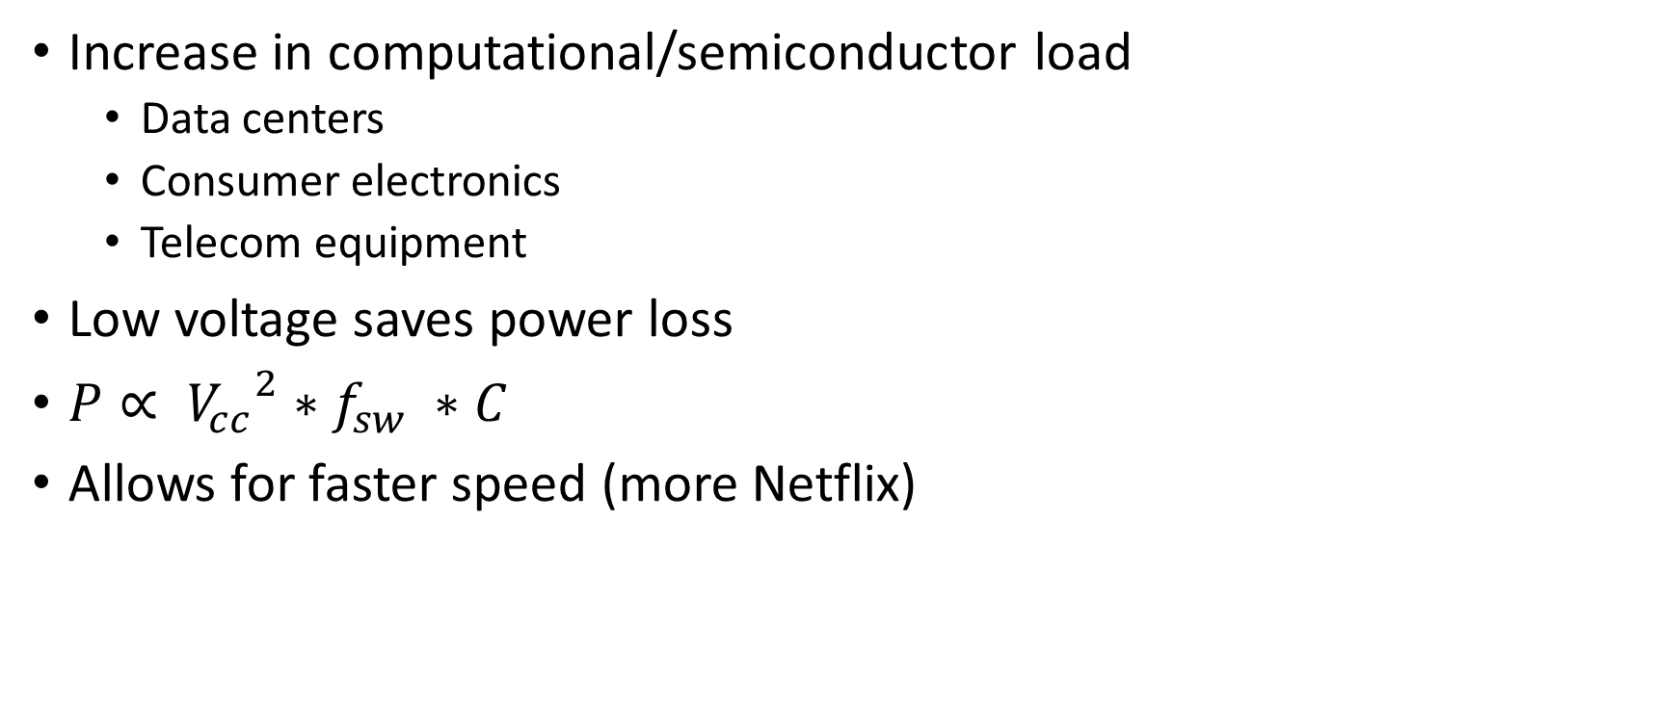
Modern power consumption likes low Voltage DC
Increase in computational/semiconductor load
Data centers
Consumer electronics
Telecom equipment
Low voltage saves power loss
$P∝ {V_{cc}}^{2}∗f_{sw} ∗C$
Allows for faster speed (more Netflix)

Slide 5
Power conversion is what goes in between
Power generation/distribution
Power conversion
Power consumption

Slide 6
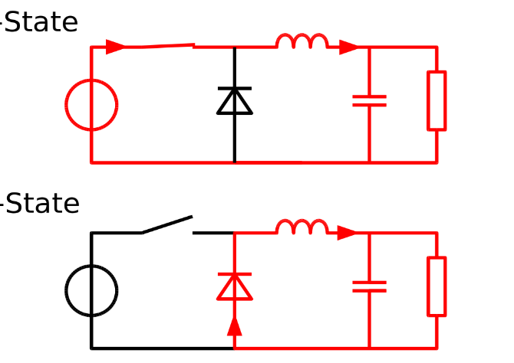
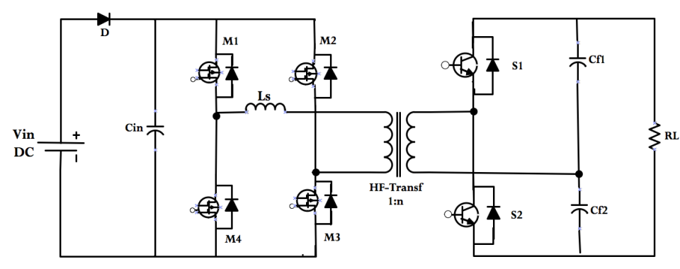
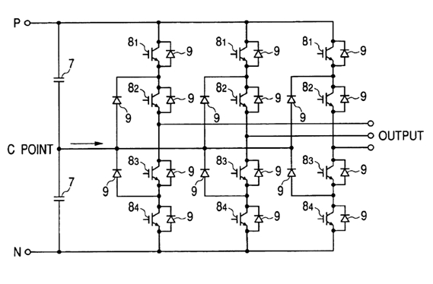
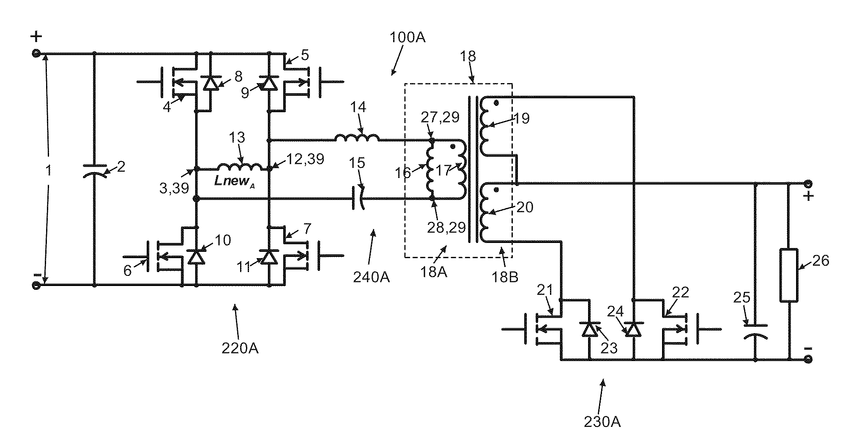
What does a typical power converter looks like

Slide 7
Analog to Digital control
Traditionally control are done via analog methods
Digital control pros
Cheaper
More Flexible
More efficient
Challenges in digital control
High speed PWM
Discrete mathematics
Quantization error

Slide 8
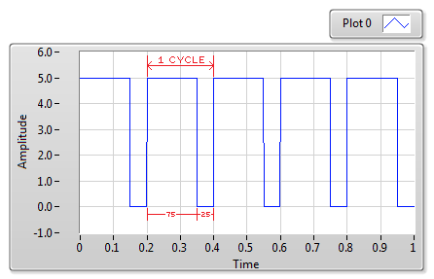
Pulse Width Modulator (PWM)
PWM is an integral part in many control schemes
Used for controlling DC motors, hydraulics, heating elements, and other mechanical components
Duty cycle refers to the percentage of on time during one cycle

Slide 9
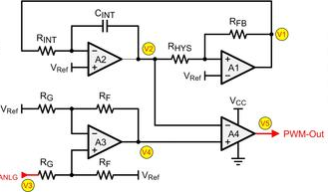
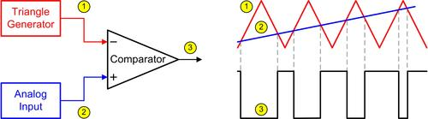
Analog PWM
Comparator is used to produce the square wave by using a triangle wave generator and a DC signal
Duty cycle determined by the DC signal voltage
High component count – more board space

Slide 10
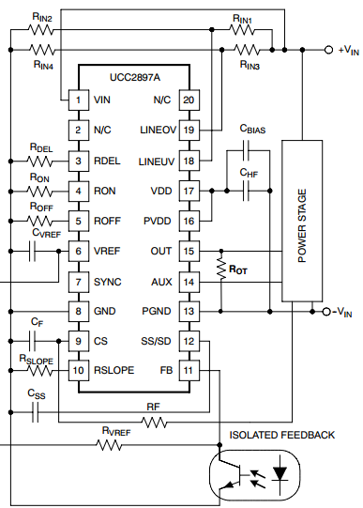
Basic Digital PWM
PWM ICs are very popular in many designs
Low cost and easy to implement
Vary the values of resistors and capacitors to change up the functionality
Can have many functions in a relatively small package

Slide 11
More advanced digital PWM
Microcontrollers are becoming more popular in designs
Flexible alternative to the analog PWM and more basic digital PWM
Can be programmed to have many different features
One chip can be used for various applications
More immune to environmental changes

Slide 12
Works Cited
Kugelstadt, Thomas. "Signal Chain Basics #76: Design a Low-Cost PWM Circuit for Single IGBT-Drive Applications." Planet Analog. N.p., 17 Apr. 2013. Web. 02 Nov. 2014.
"What Is a Pulse Width Modulation (PWM) Signal and What Is It Used For?" National Instruments. N.p., 31 Jan. 2014. Web. 02 Nov. 2014.

